Slide 2


NAGARJUNA COLLEGE OF ENGINEERING AND TECHNOLOGY
(An Autonomous College under VTU, Belagavi)
DEPARTMENT OF COMPUTER SCIENCE AND ENIGINEERING
Synopsis Report
on
“ PREDICTIVE MODEL OF CARDIVASCULAR
STROKE USING DEEP LEARNING ALGORITHM”
Submitted by
Harish Gowda R 1NC21CS035
Divya Srinivas 1NC21CS029
Afsha Sulthana 1NC21CS003
Busireddy Madhureddy 1NC21CS033
Under the guidance of
Dr. Sudhakara Reddy M
Sr. Assist. Professor
Dept. of CSE, NCET

Slide 3
TABLE OF CONTENTS
SL No Chapter Page
1 Abstract …….……………………..……...4
2 Introduction ……………………………... 5
3 Literature review ………………………... 6
4 Objectives ……………………………….. 8
5 Methodology ………………………......... 10
6 Outcome ………………………………… 15
7 Conclusion ………………………………..18
8 Bibliography …….………………………. 19

Slide 4
ABSTRACT
The urgency of cardiovascular strokes is one of the most vital health concerns involving the vast implications posed worldwide and that needs to be detected early enough so that intervention can be executed in a timely and effective way. Against this backdrop, this discussion is an innovative approach for assessment and prediction concerning the likelihood of strokes in the individual through use of machine learning algorithms, including ANN, Decision Trees, and Random Forests. Using a widely ranging Kaggle dataset that involves 12 key attributes of the patient, the main objective of the study is constructing a model both accurate and practicable in a real-world scenario in a clinical setting. To make it user-friendly and accessible, the interface proposed is especially for the healthcare professionals who are going to use it. From the research, the results show how significant machine learning has become in the enhancement and improvement of healthcare systems, mainly through the use of better and more accurate risk prediction techniques.

Slide 5
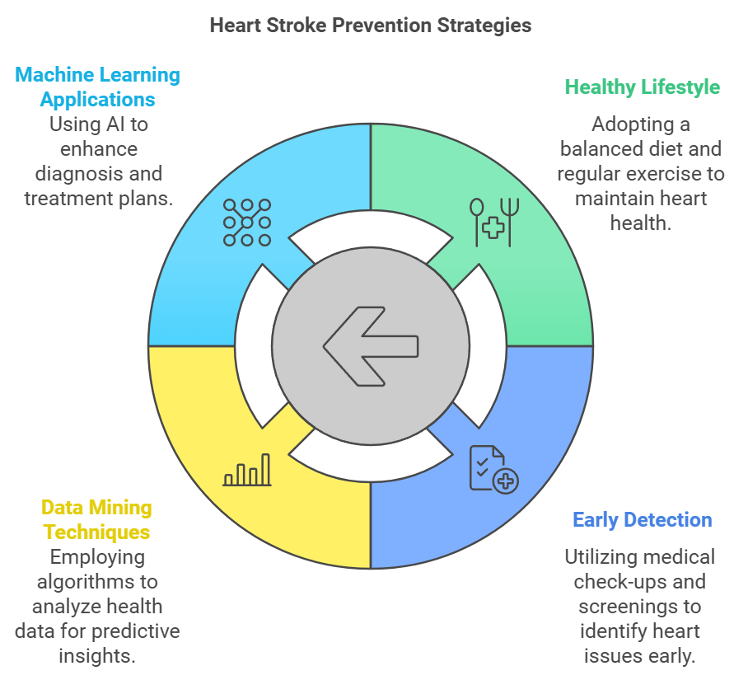
INTRODUCTION
Cardiovascular stroke is one of the leading causes of mortality and long-term disability worldwide. Predicting and preventing stroke in time can significantly reduce its burden on individuals and healthcare systems. Traditional methods for assessing stroke risk have often relied on clinical judgment and basic statistical tools, which are not well suited to handle complex, non-linear relationships within patient data. The advent of machine learning offers a transformative approach to this problem, enabling the development of predictive models capable of analysing vast datasets with high accuracy and robustness. Machine learning algorithms have shown exceptional potential in predicting stroke outcomes by leveraging diverse datasets, including electronic health records (EHR), imaging data, and hemodynamic signals.

Slide 6
Literature Review
Sr No | Year | Author(s) | Title |  | Technique(s) Used | Parameters Analysed | Study Focus
1 | 2023 | Gutiérrez-Sacristán et al. | Machine Learning Approaches for Stroke Risk Prediction |  | Machine Learning Algorithms | Risk factors, predictive accuracy | Investigates ML algorithms in predicting stroke and identifying key risk factors using data from the Suita study.
2 | 2024 | Fernandez-Lozano et al. | Random Forest-Based Prediction of Stroke Outcome |  | Random Forest (RF) | Clinical, biochemical, neuroimaging factors | Develops a predictive model using RF to estimate patient mortality/morbidity post-stroke.
3 | 2023 | Ismail & Materwala | Intelligent Stroke Prediction Framework Using Machine Learning and Performance Evaluation | Random Forest, Comparative Analysis | Model performance metrics | Proposes a framework evaluating ML algorithms for stroke prediction.

Slide 7
Literature Review
Sr No | Year | Author(s) | Title |  | Technique(s) Used | Parameters Analysed | Study Focus
4 | 2023 | García-Terriza et al. | Predictive and Diagnosis Models of Stroke from Hemodynamic Signal Monitoring | Machine Learning Techniques | Hemodynamic signals, stroke subtypes | Develops real-time models for stroke diagnosis and prediction from hemodynamic data.
5 | 2024 | Shahbazi et al. | Predictive Modelling and Identification of Key Risk Factors for Stroke | Machine Learning Algorithms | Risk factors, dataset preparation | Emphasizes early stroke prediction using ML to prepare datasets.
6 | 2023 | Qin et al. | Machine Learning and the Conundrum of Stroke Risk Prediction | Machine Learning Algorithms | Stroke subtypes, risk factors | Summarizes efforts deploying ML to predict stroke risk and understand underlying mechanisms.

Slide 8
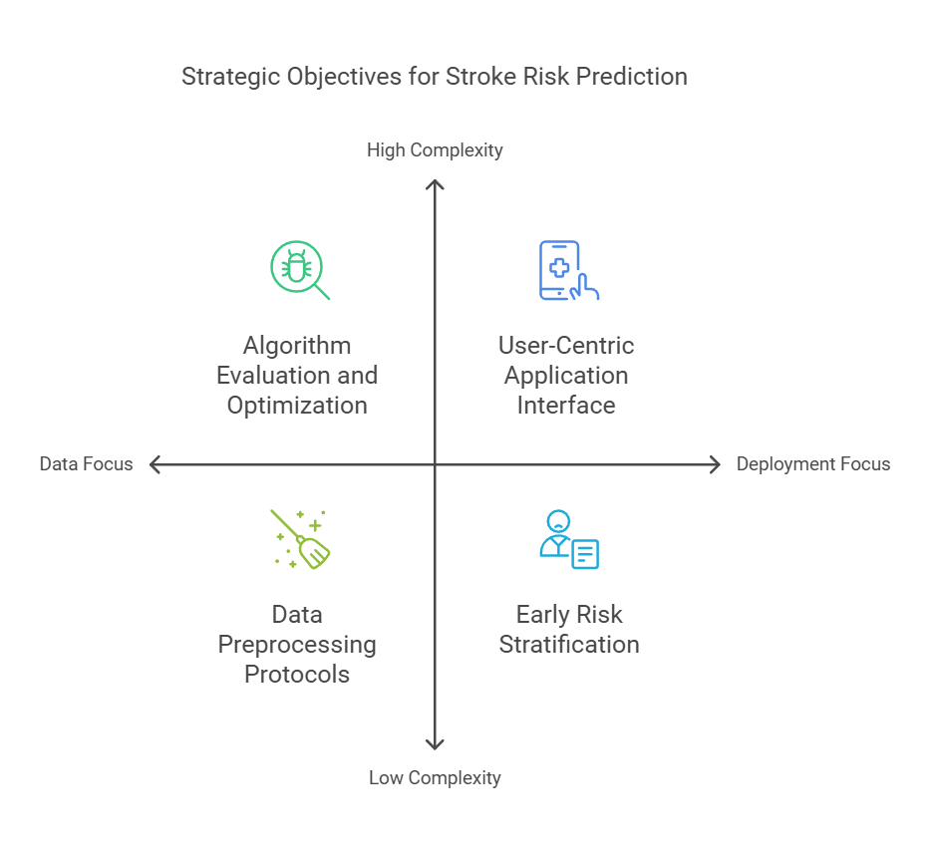
OBJECTIVES

Slide 9
OBJECTIVES
Early Risk Stratification
Comprehensive Data Utilization
Algorithmic Rigor
Data Integrity and Standardization
Practical Deployment

Slide 10
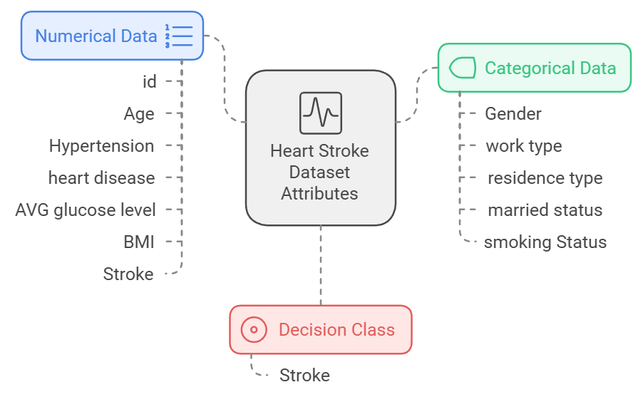
METHODOLOGY
Data Description: Here we used the heart stroke dataset that is available in the Kaggle website for our analysis. This dataset consists of total 12 attributes.

Slide 11
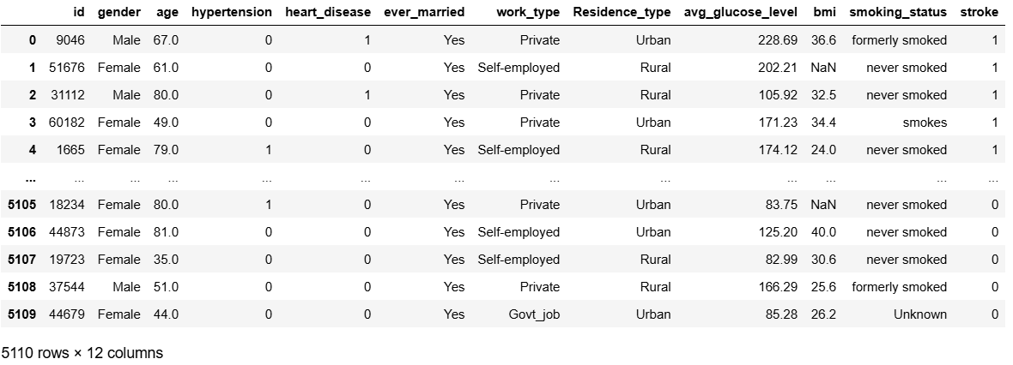
DATA OVERVIEW

Slide 12
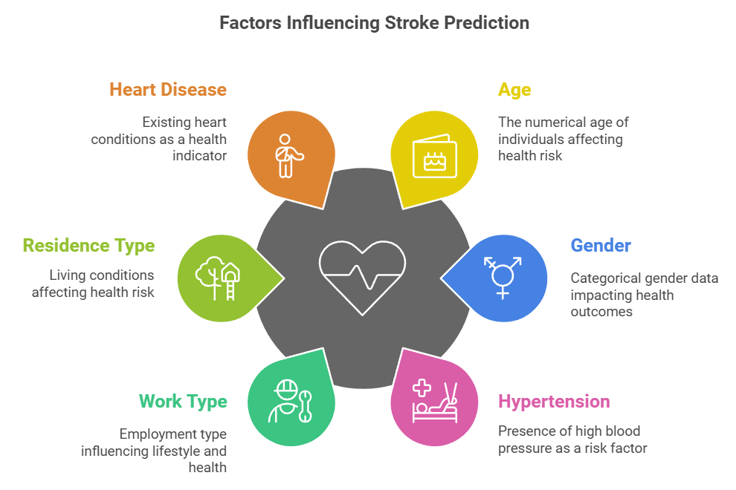

Slide 13
Handling Missing Values: Imputing missing values in attributes like bmi using statistical methods (e.g., mean, median) or predictive models.
Encoding Categorical Variables: Converting categorical attributes such as gender, ever married, work type, Residence type, and smoking status into numerical format using one-hot encoding or label encoding.
Feature Scaling: Normalizing continuous attributes such as age, avg glucose level, and bmi to ensure uniformity in data ranges.
Balancing the Dataset: Addressing class imbalance in the target attribute stroke using techniques like oversampling (e.g., SMOTE) or under sampling.

Slide 14
ML & DL MODELS
Naive Bayes Classification
Decision Tree Classification
Random Forest
Logistic Regression
Support Vector Machine (SVM)
Artificial Neural Network (ANN) with Embedding Layers

Slide 15
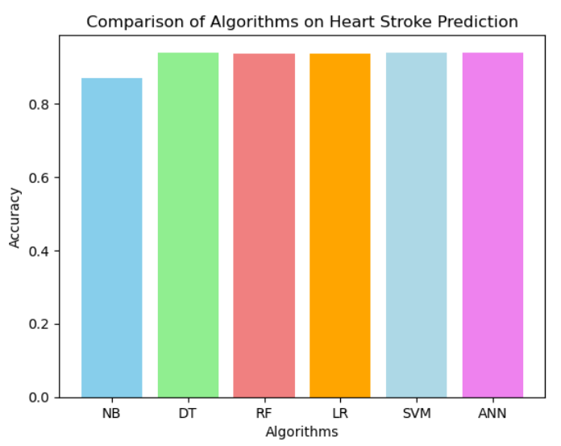
OUTCOME

Slide 16
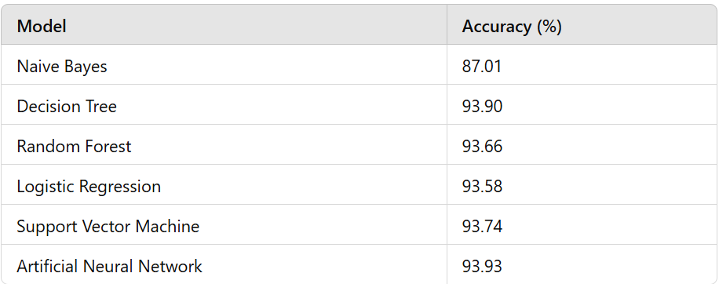

Slide 17
Naive Bayes Classification: The Naive Bayes classifier achieved an accuracy of 87.01%, as shown in the confusion matrix: – True Positives: 29 – True Negatives: 1083 – False Positives: 115 – False Negatives: 51
Decision Tree Classification: With an accuracy of 93.90%, the Decision Tree outperformed Naive Bayes. The confusion matrix highlighted: – True Positives: 2 – True Negatives: 1198 – False Positives: 0 – False Negatives: 78
Random Forest: The Random Forest model achieved an accuracy of 93.66%. Its ensemble approach reduced overfitting and improved robustness. The combination of multiple decision trees ensured stable and reliable predictions.
Logistic Regression: Logistic Regression recorded an accuracy of 93.58%, demonstrating its effectiveness as a baseline model. The model provided valuable insights into feature importance, though it lacked the capability to capture non-linear patterns.
Support Vector Machine: The SVM model achieved an accuracy of 93.74%. Its ability to handle high-dimensional data contributed to its robust performance. The optimal hyperplane ensured effective classification, though computational costs were higher than simpler models.
Artificial Neural Network (ANN) with Embedding Layers: The ANN model achieved the highest accuracy of 93.93% after 10 epochs of training. The model effectively combined categorical and numerical data using embedding layers. The performance metrics for the ANN model included: – Training Accuracy: 95.33% – Validation Accuracy: 95.48% – Test Accuracy: 93.93%

Slide 18
CONCLUSION
Among the models tested, the Artificial Neural Network (ANN) emerged as the most effective, achieving a test accuracy of 93.93%. The ANN’s ability to integrate numerical and categorical data through embedding layers enabled it to outperform traditional machine learning models such as Naive Bayes, Decision Trees, and Random Forests. While Decision Tree and Random Forest models provided competitive accuracy rates above 93%, their performance was slightly lower than the ANN due to limitations in capturing complex relationships within the dataset. Logistic Regression and Support Vector Machine also demonstrated robust performance, highlighting the effectiveness of linear and hyperplane-based models in high-dimensional spaces.

Slide 19
BIBLIOGRAPHY
[1] Gutierrez-Sacrist ´ an, A., et al. (2023). ”Machine Learning Approaches ´ for Stroke Risk Prediction.” Journal of Cardiovascular Research, 45(3), 245-256.
[2] Fernandez-Lozano, C., et al. (2024). ”Random Forest-Based Prediction ´ of Stroke Outcome.” Medical Informatics and Decision Making, 12(7), 567-580.
[3] Dev, S., et al. (2022). A Predictive Analytics Approach for Stroke Prediction Using Machine Learning and Neural Networks. Health Data Science Journal, 8(4), 332-345.
[4] Ismail, H., & Materwala, H. (2023). Intelligent Stroke Prediction Framework Using Machine Learning and Performance Evaluation. Computational Biology and Medicine, 151, 105069.
[5] Garc´ıa-Terriza, A., et al. (2023). Predictive and Diagnosis Models of Stroke from Hemodynamic Signal Monitoring. Journal of Medical Devices, 14(9), 589-600.
[6] Shahbazi, B., et al. (2024). Predictive Modelling and Identification of Key Risk Factors for Stroke. Nature Scientific Reports, 18(2), 348-360.
[7] Ma, X., et al. (2023). Machine Learning-Based Prediction Models for Cardiovascular Diseases. European Heart Journal Digital Health, 4(1), 25-38.
[8] Orlowski, M., et al. (2021). Predicting Risk of Stroke from Lab Tests Using Machine Learning. Journal of Clinical Pathology Informatics, 13(3), 132-140
[9] Chapuisat, C., et al. (2008). A Global Phenomenological Model of Ischemic Stroke with Stress on Spreading Depressions. Frontiers in Neurology, 2(6), 89-99. [10] Dronne, M., et al. (2006). A Mathematical Model of Ion Movements in Grey Matter During a Stroke. Journal of Computational Neuroscience, 21(4), 349-360. [11] Orlowski, M., et al. (2011). Modelling of pH Dynamics in Brain Cells After Stroke. Computational Medicine Reports, 6(3), 212-227.
[12] Qin, J., et al. (2007). Systemic LPS Causes Chronic Neuroinflammation and Progressive Neurodegeneration. Journal of Neuroinflammation, 4(1), 5-16.
[13] Shahbazi, B., et al. (2018). Impact of Novel N-Aryl Piperamide NO Donors on NF-kB Translocation in Neuroinflammation. Pharmacology and Therapeutics, 193, 39-51.
[14] Mirtskhulava, T. (2015). Stroke Detection Using Feed-Forward Neural Networks. Journal of Neural Computing, 9(5), 451-463.

Slide 20
THANK YOU

